Slide 1

Modeling spatial continuity
Modeling Uncertainty in the Earth Sciences
Jef Caers
Stanford University

Slide 2
Motivation

Slide 3
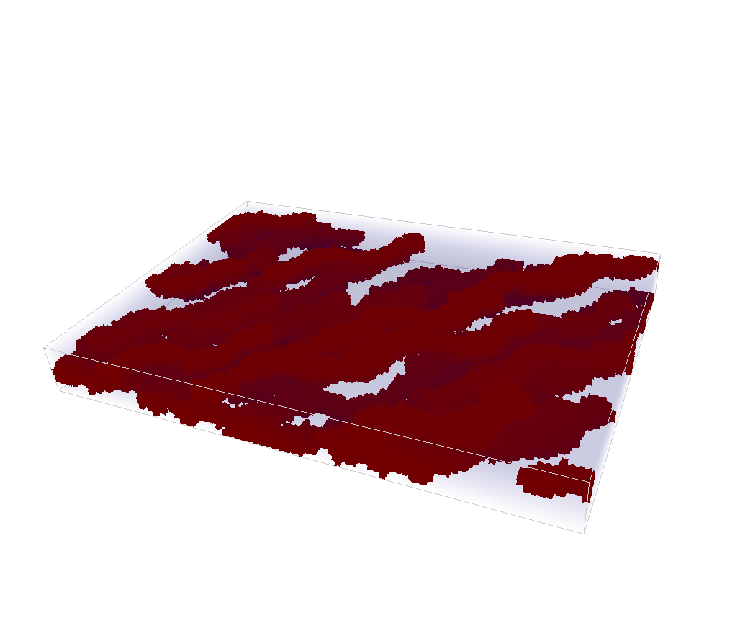
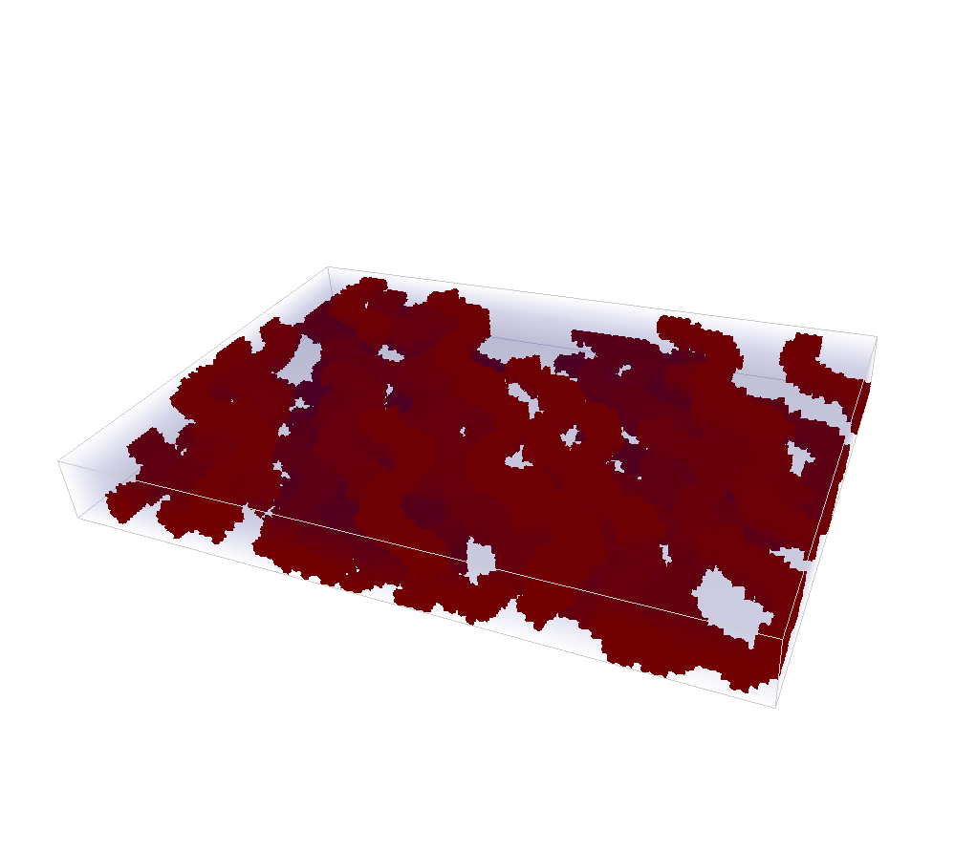
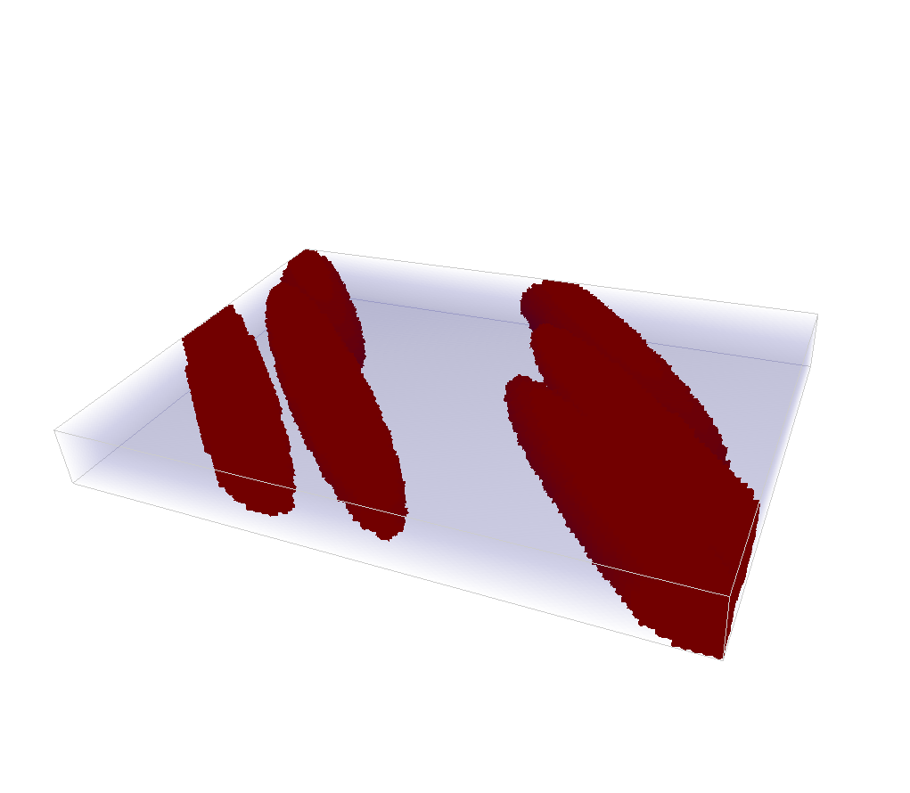
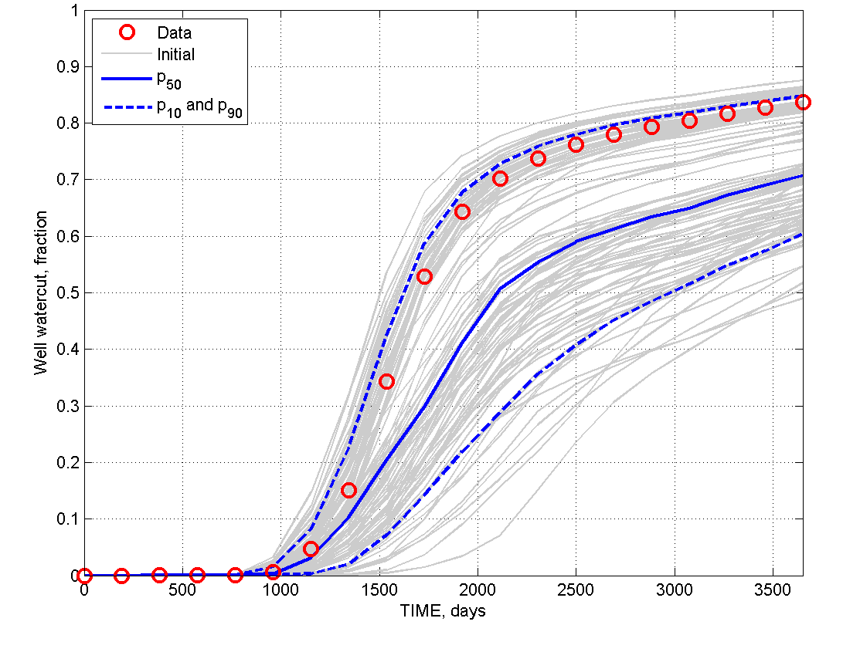
Motivation
Calculate expected
costs / profits
Build models
Get responses

Slide 4
Motivation
Earth phenomena are not randomly distributed in space and time: this makes them predictable !
Surface and subsurface modeling: a medium exists that has been created by processes (geological, morphological etc…)
A form of “continuity” exists
“discontinuity” (e.g. faults) is a specific form of such continuity

Slide 5
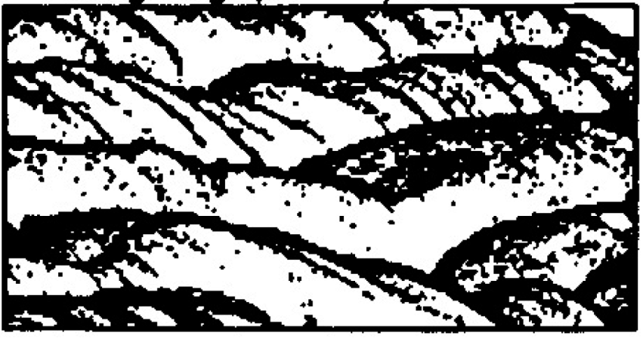
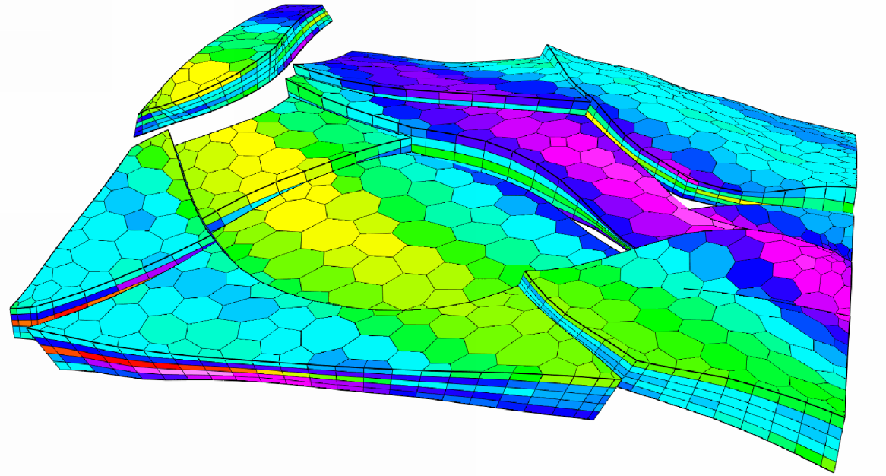
Why modeling spatial continuity?
What are mathematical or computer-based models that describe
the spatial distribution of properties observed in these
(complete or incomplete) datasets

Slide 6
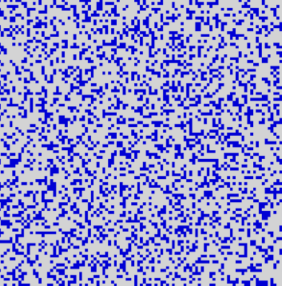
Why modeling spatial continuity?
What is the
spatial variation like ?
?
?
Data
?
?
How does one build a model
that looks like what I think is there
and constrained to data?

Slide 7
Why modeling spatial continuity?
Geologist 1
interprets channels
data
“Boolean Channel model”
“Boolean simulator”
Earth models
“Boolean Mound model”
Geologist 2
interprets mounds

Slide 8
Why modeling spatial continuity?
A model allows “filtering” and “exporting” the spatial variation seen in the dataset
Allows building “Earth models” with similar spatial variation, but possibly constrained to data
Allows randomizing the spatial variation and represent “spatial uncertainty”

Slide 9
Most common type models
Variogram-based models
Simple, few parameters
Limited modeling capabilities
Boolean (or object-based) models
More realistic
Difficult to constrain
Training image-based models
Realistic
Easy to constrain

Slide 10
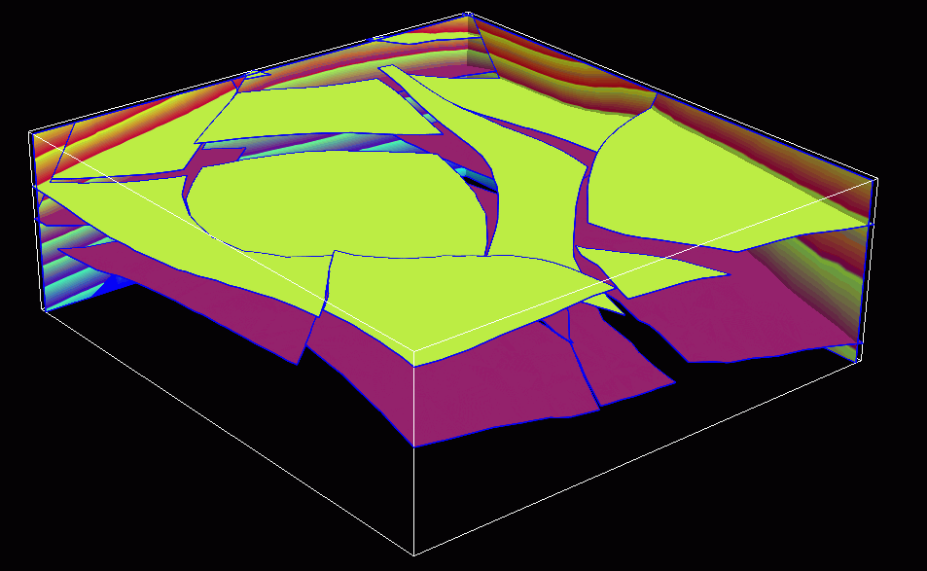
Limitations of these methods
Not applicable to modeling “structures”

Slide 11
The variogram
Modeling spatial continuity

Slide 12
Autocorrelation
t
t+Δt

Slide 13
Autocorrelation
r
1
Lag distance
Δt

Slide 14
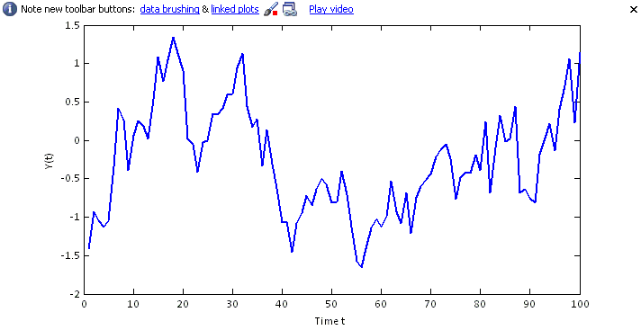
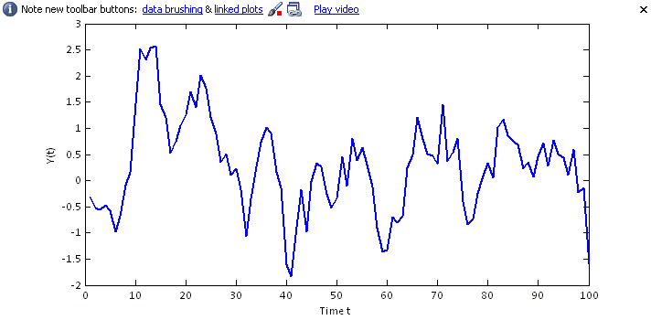
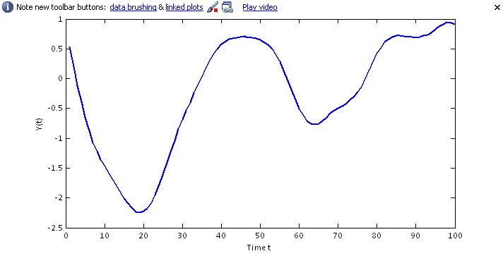
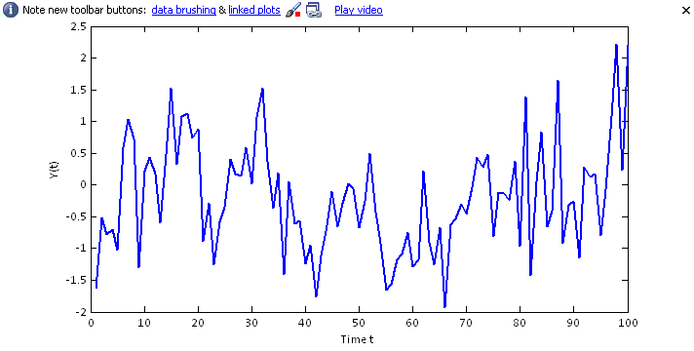
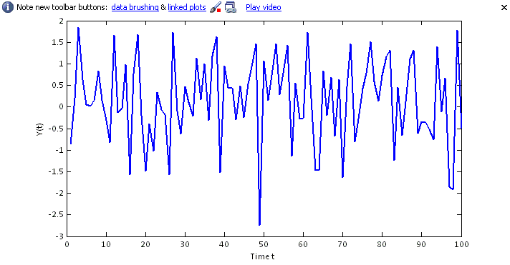
Case 1
Case 2
Case 3
Case 4
Case 5

Slide 15
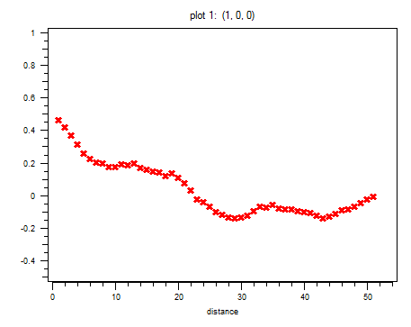
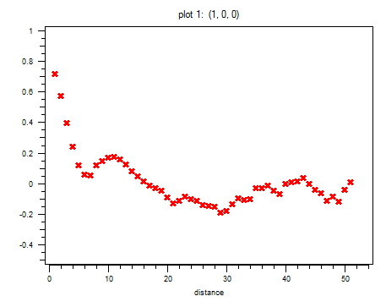
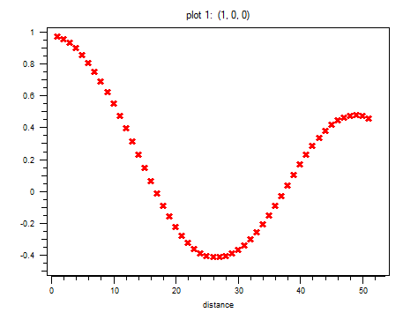
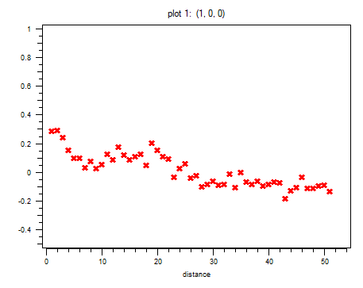
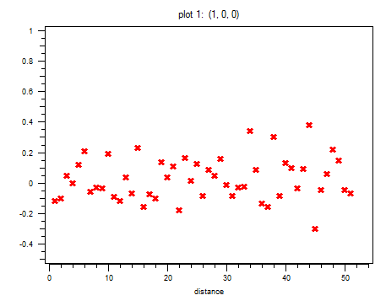
Case 1
Case 2
r(t)
r(t)
Time Δt
Case 3
Time Δt
r(t)
Case 4
Time Δt
Case 5
r(t)
r(t)
Time Δt
Time Δt

Slide 16
Autocorrelation in 2D
1
r(|h|)
Lag distance |h|

Slide 17
Properties of the correlogram
Always starts at 1
Decreases to zero
1
r(|h|)
correlation length
Lag distance |h|

Slide 18
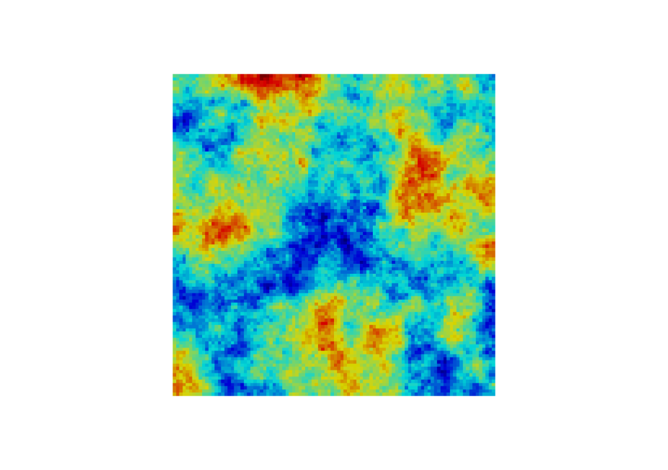
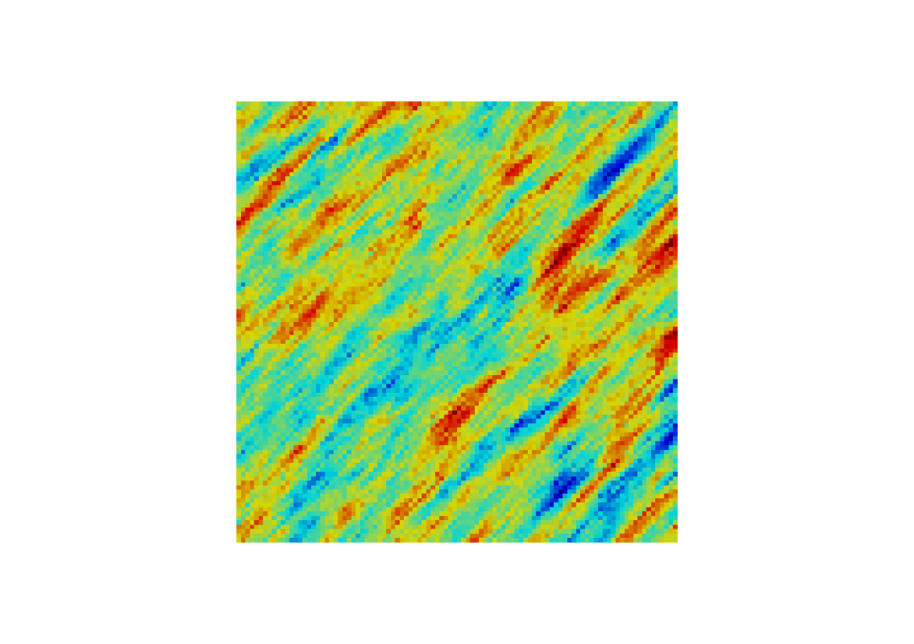
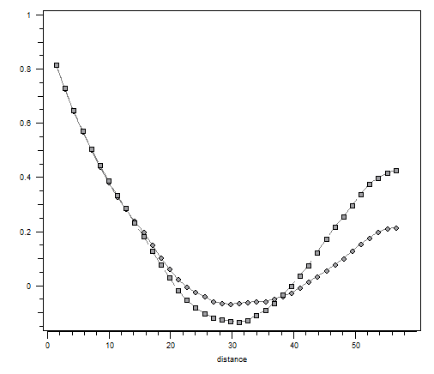
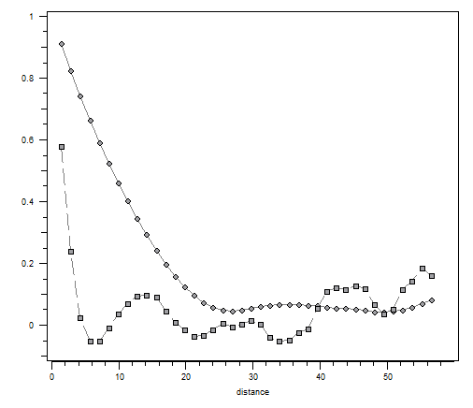
Examples
Case 1
Case 2
NW direction
NW direction
NE direction
NE direction
r(h)
r(h)
Distance h
Distance h

Slide 19
Examples

Slide 20
Other representations

Slide 21
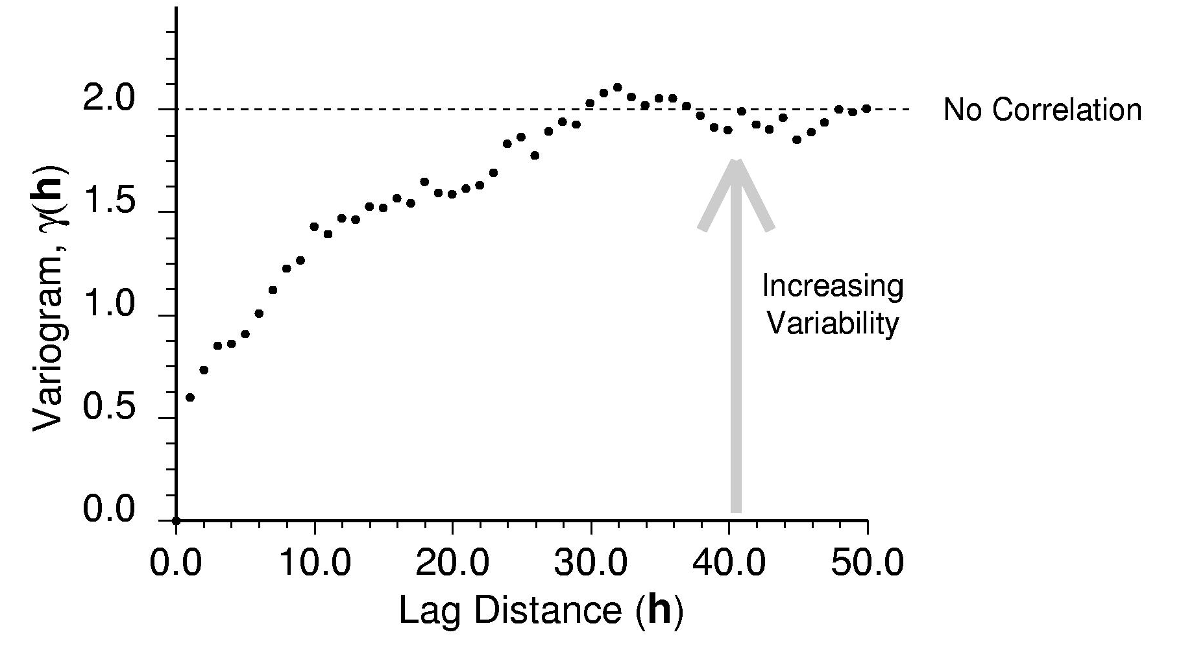
Typical experimental (semi)-variogram
Sill
Range
Nugget

Slide 22
Summarizing variograms
What is the range and how does it vary with direction
What is the nugget effect
What is the behavior at the origin
What is the sill value
These four elements constitute a model,
i.e. you summarized a complex spatial variation
with a limited set of parameters

Slide 23
Why modeling spatial continuity?
What is the
spatial variation like ?
?
?
Data
?
?
How does one build a model
that looks like what I think is there
and constrained to data?

Slide 24
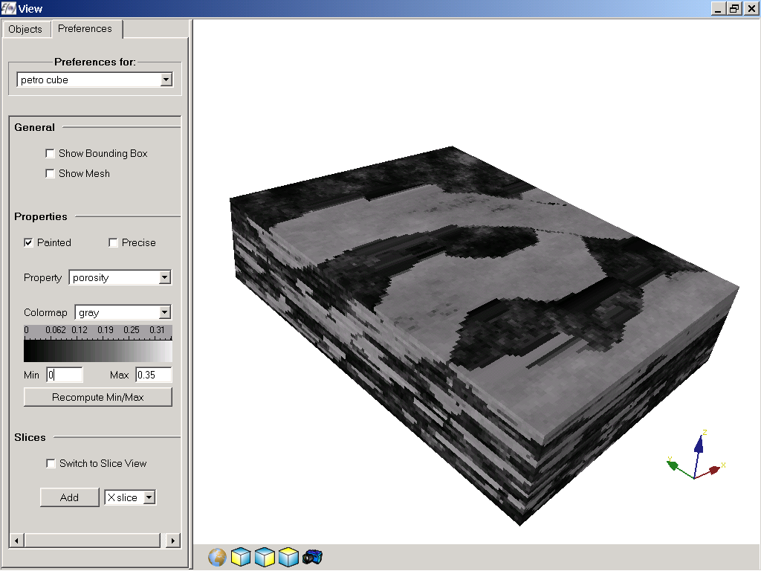
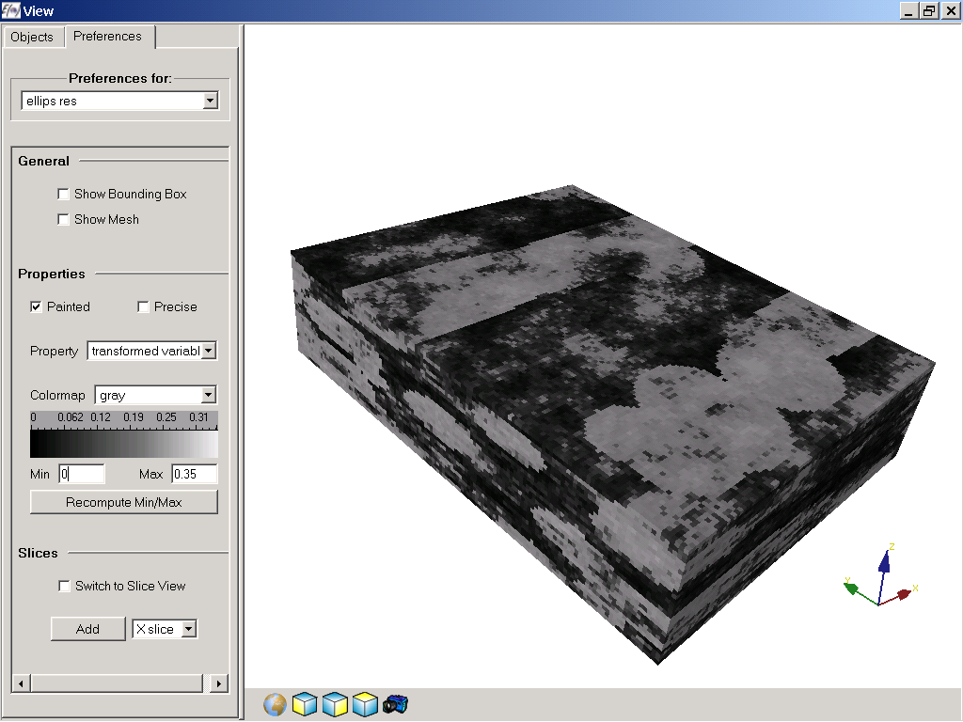
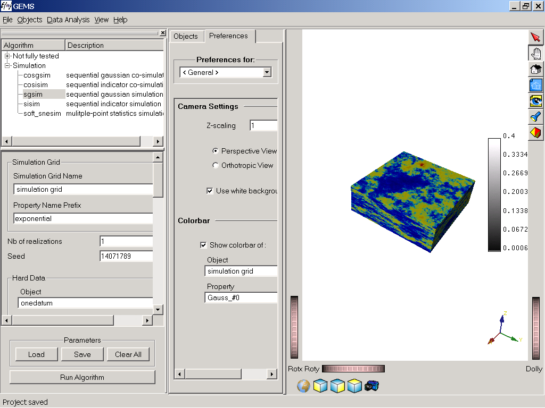
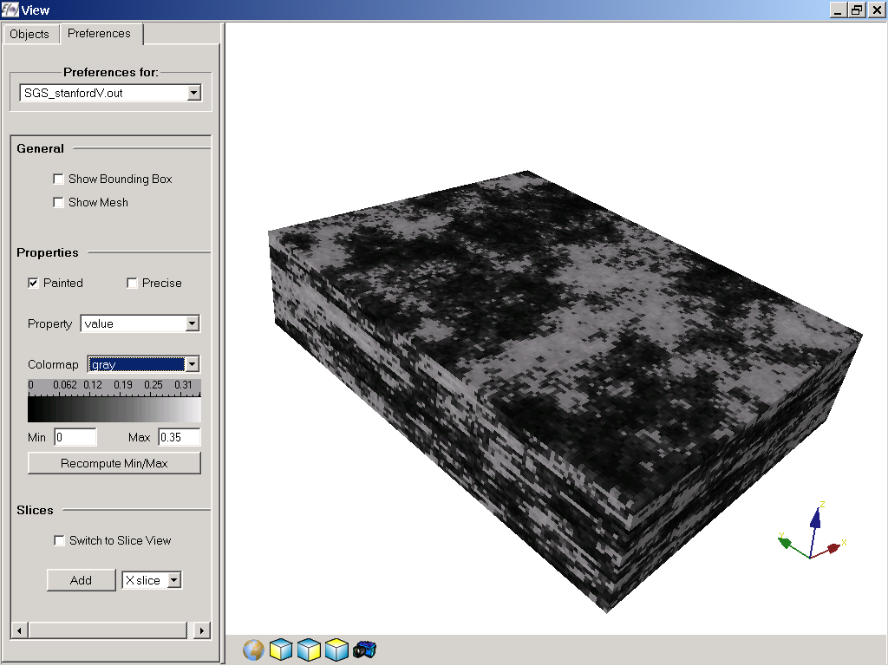
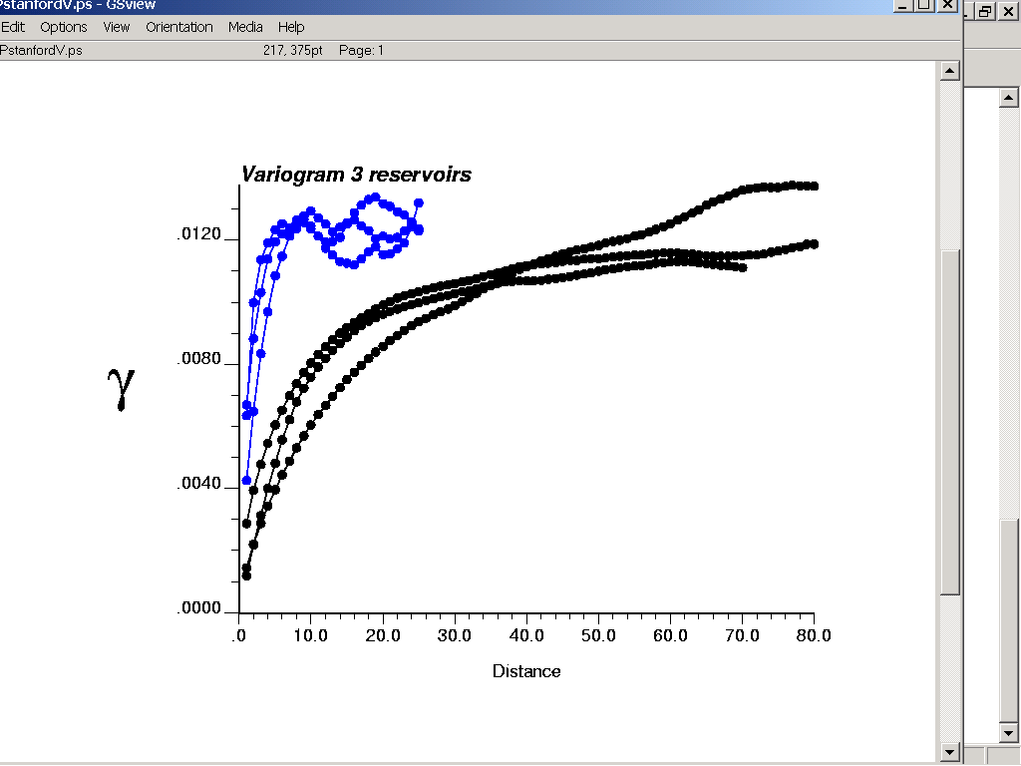
Limitations of variograms
Variograms: modeling “homogeneous heterogeneity”
for modeling properties within major layers or facies
Vertical variogram
Horizontal variogram

Slide 25
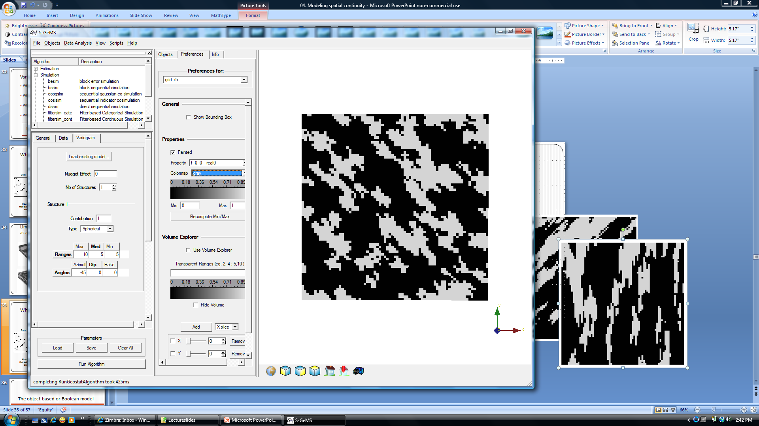
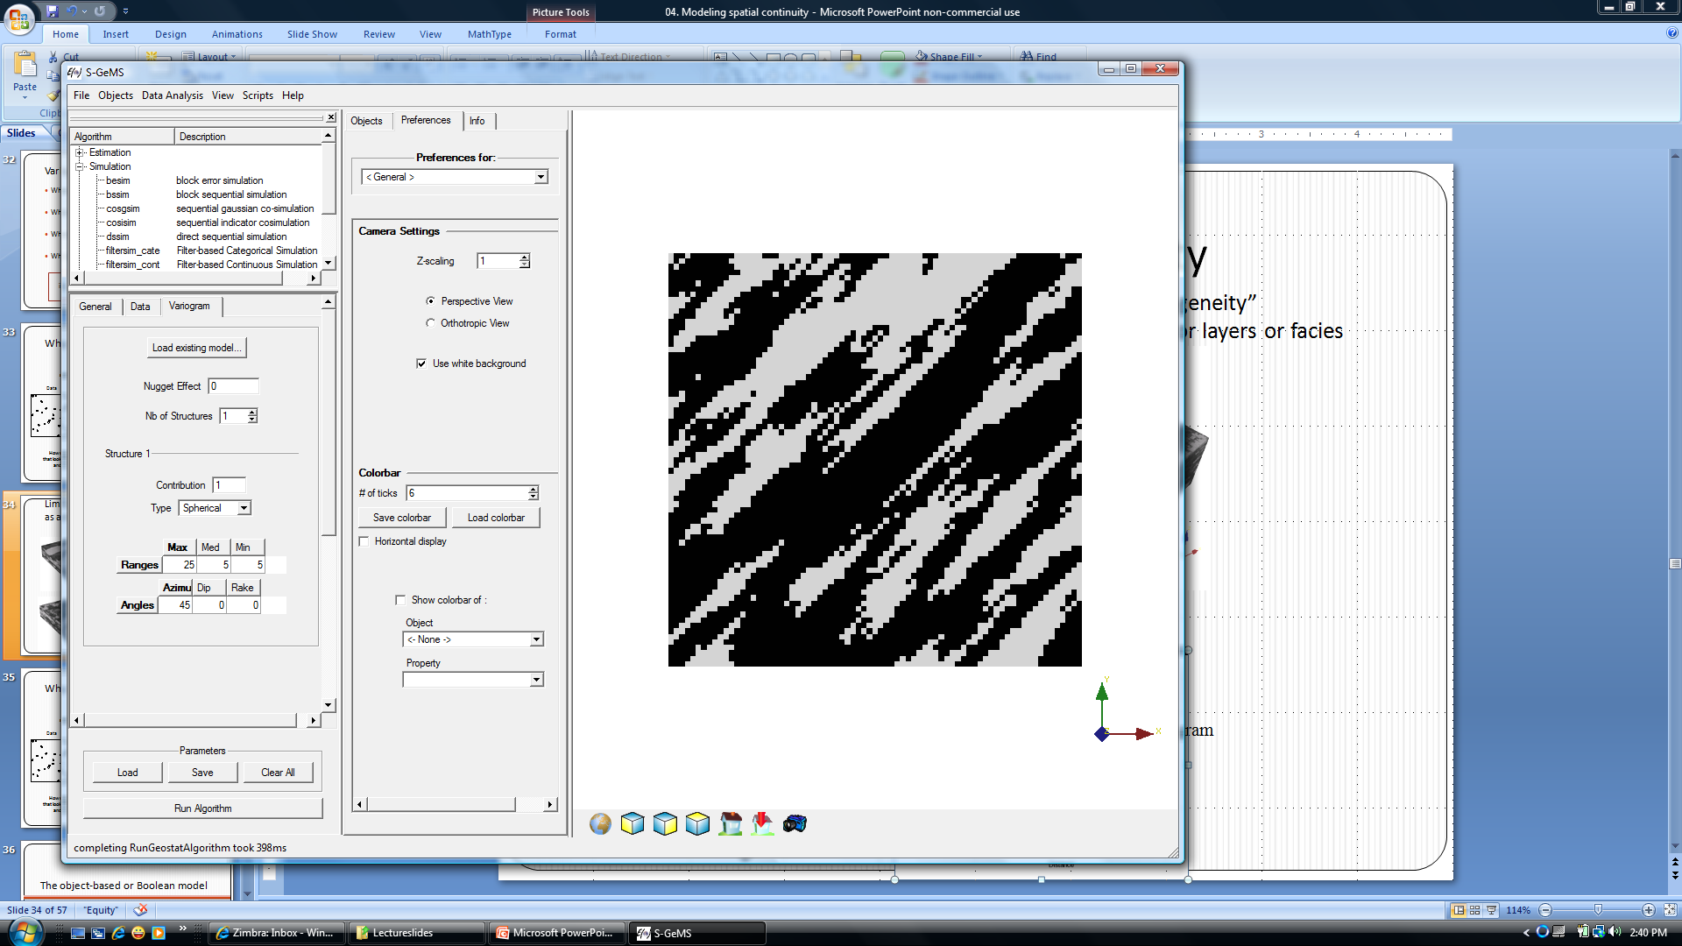
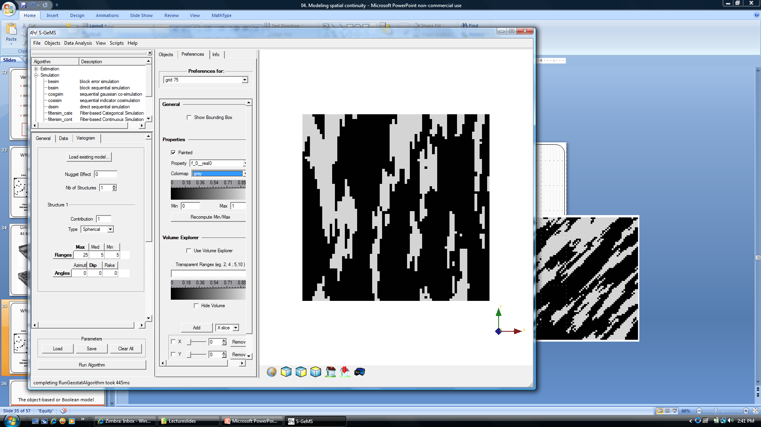
Limitations of the variogram
What is the
spatial variation like ?
?
?
Data
?
?
How does one build a model
that looks like what I think is there
and constrained to data?

Slide 26
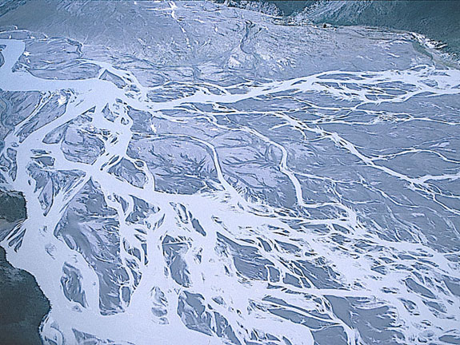
What does the Earth really look like?

Slide 27
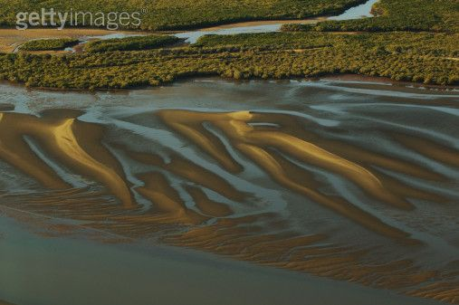
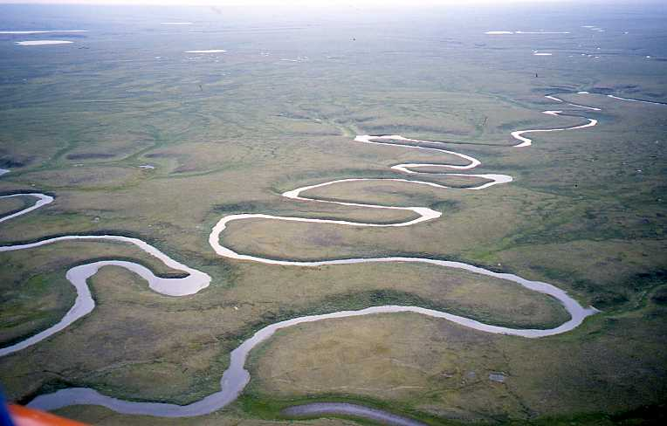
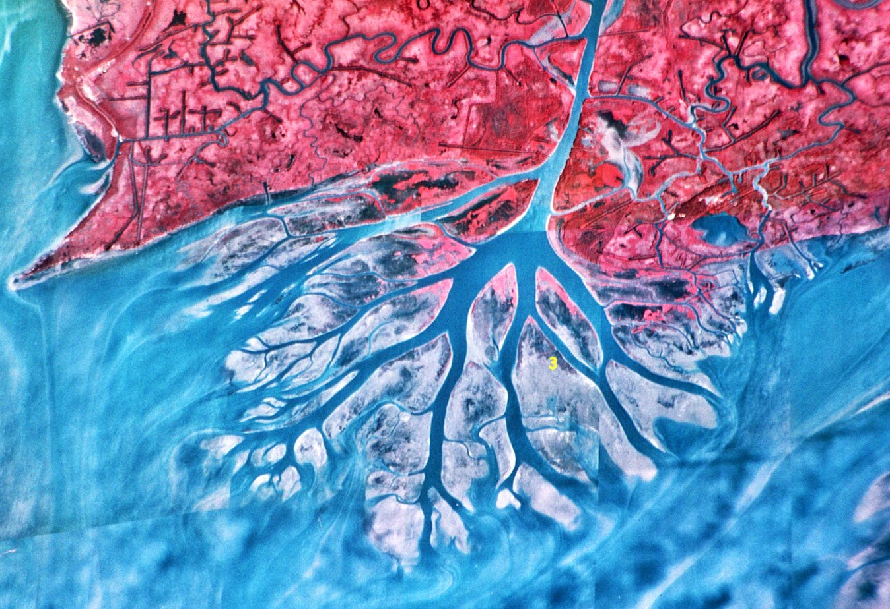

Tidal sand bars
Meandering rivers
Deltas
Craters

Slide 28
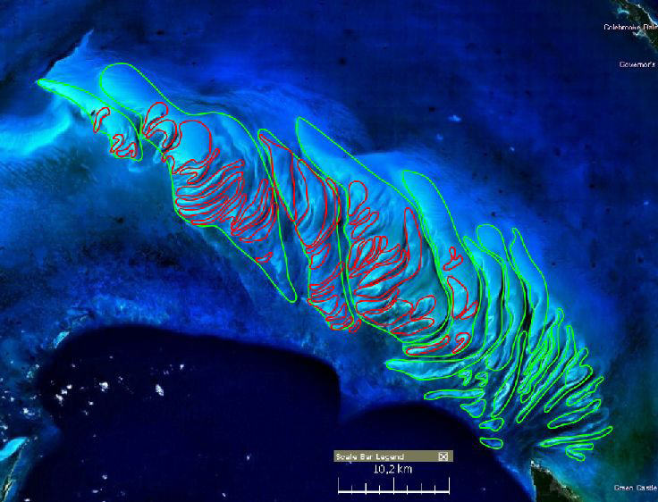
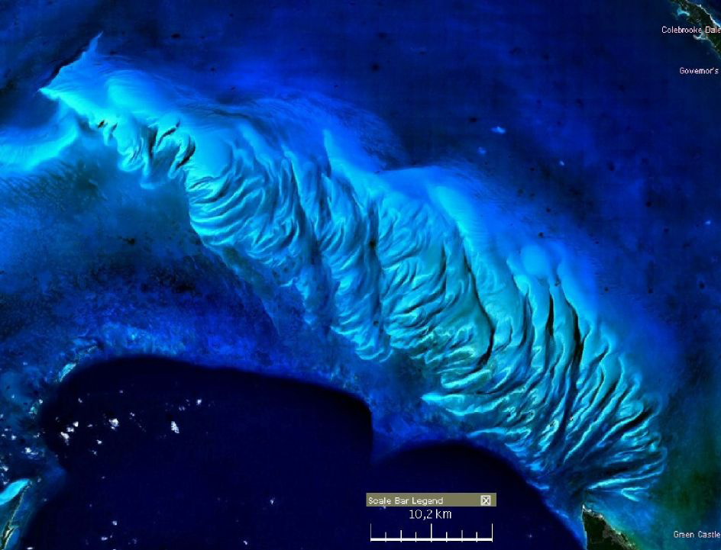
Carbonate Reefs (today)

Slide 29
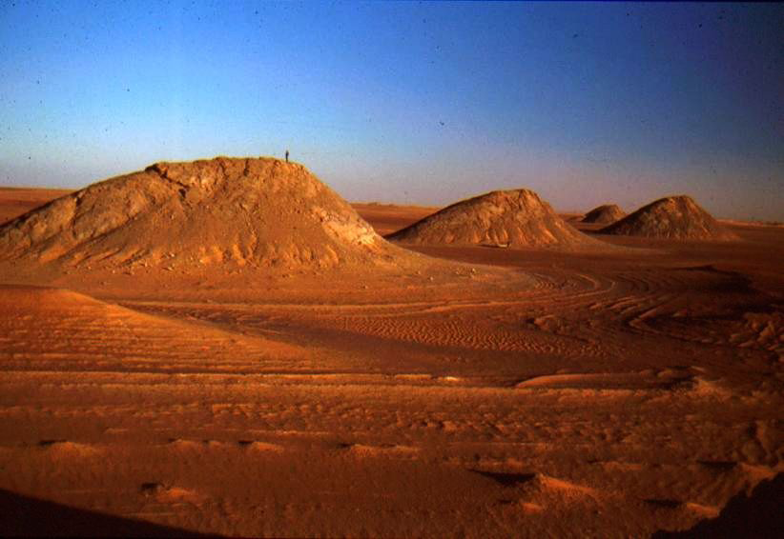
Carbonate Mounds (paleo)

Slide 30
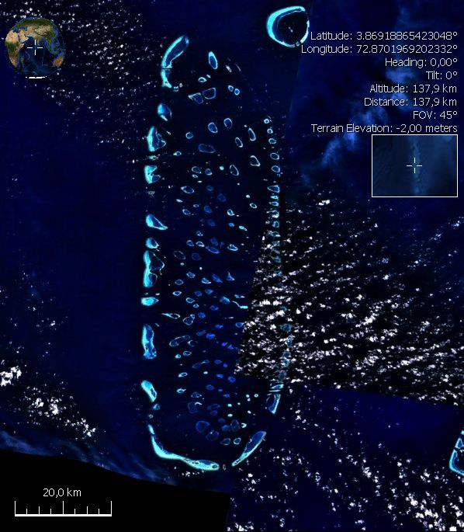
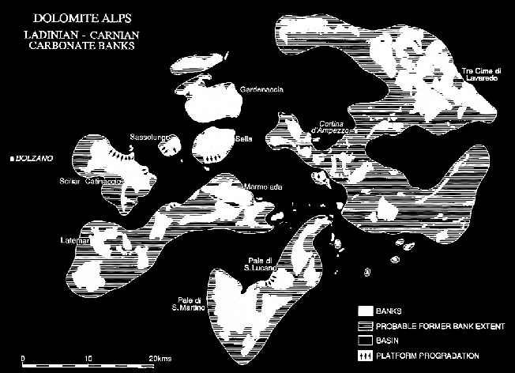
Atol (today)
Atol (paleo)

Slide 31
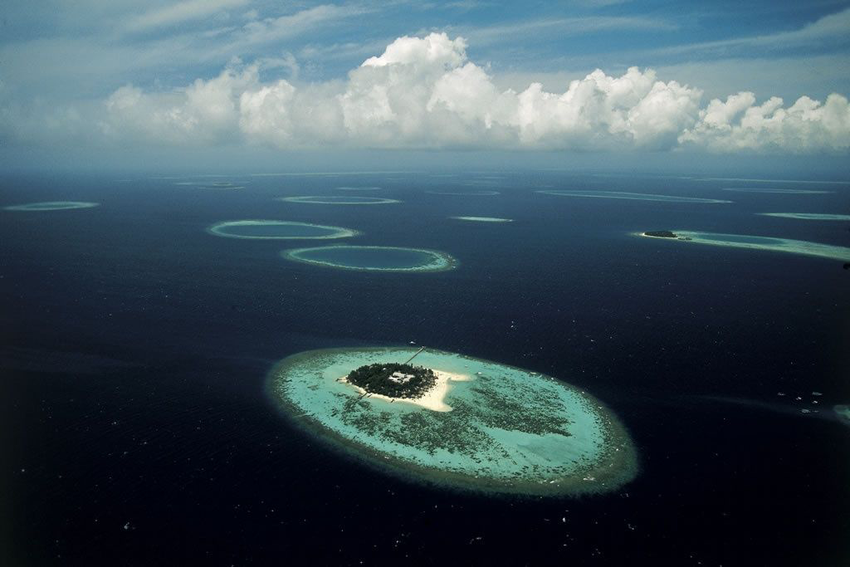
Spatial distribution of Atols

Slide 32
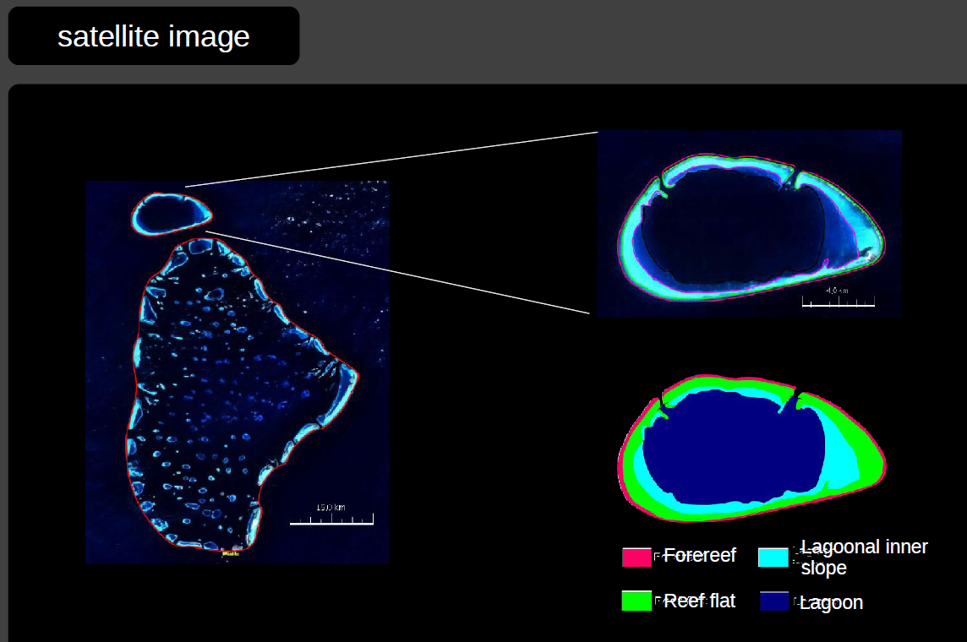
Inner architecture of an Atol

Slide 33
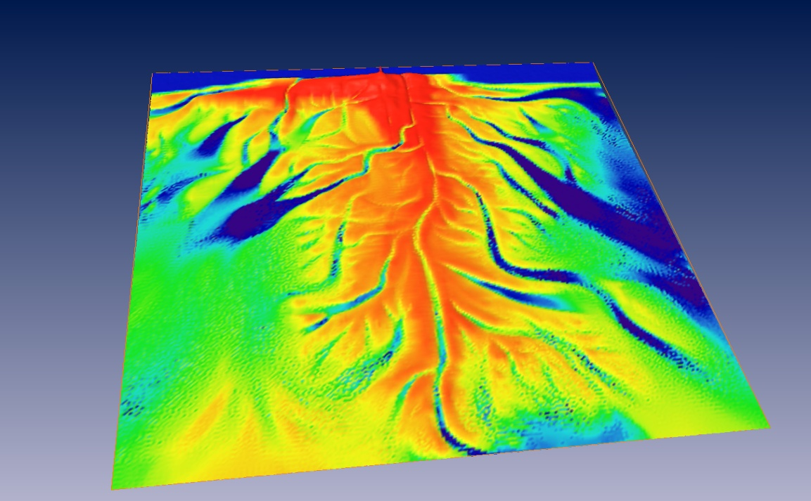
How to create Earth models that represent this observation ?
“Simulate” the physical processes of deposition on a computer
Observed
Simulated

Slide 34
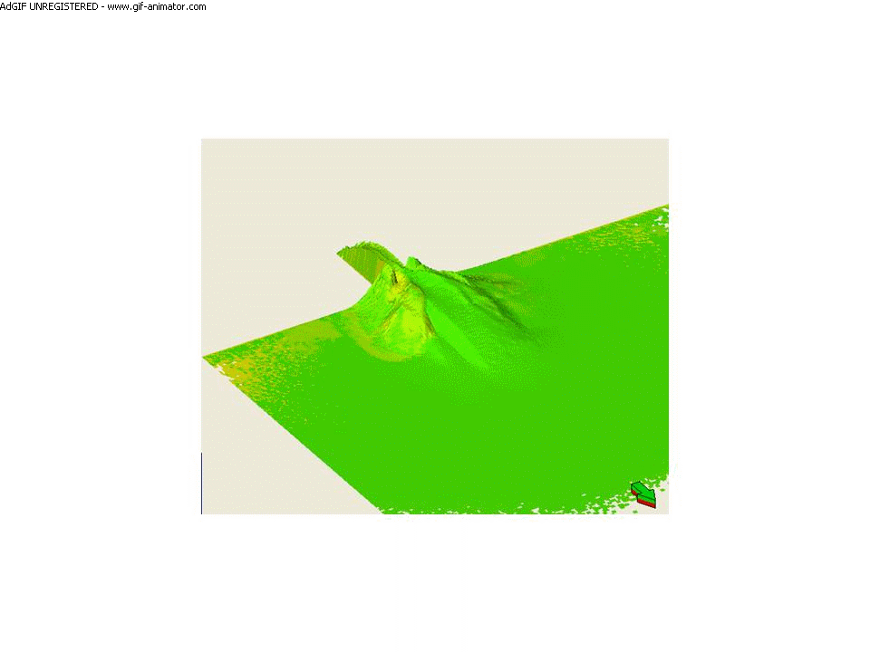
Physical-process models

Slide 35
Physical process models
Take weeks to run on a computer
Results are deterministic: one computer run = one model => NO UNCERTAINTY

Slide 36
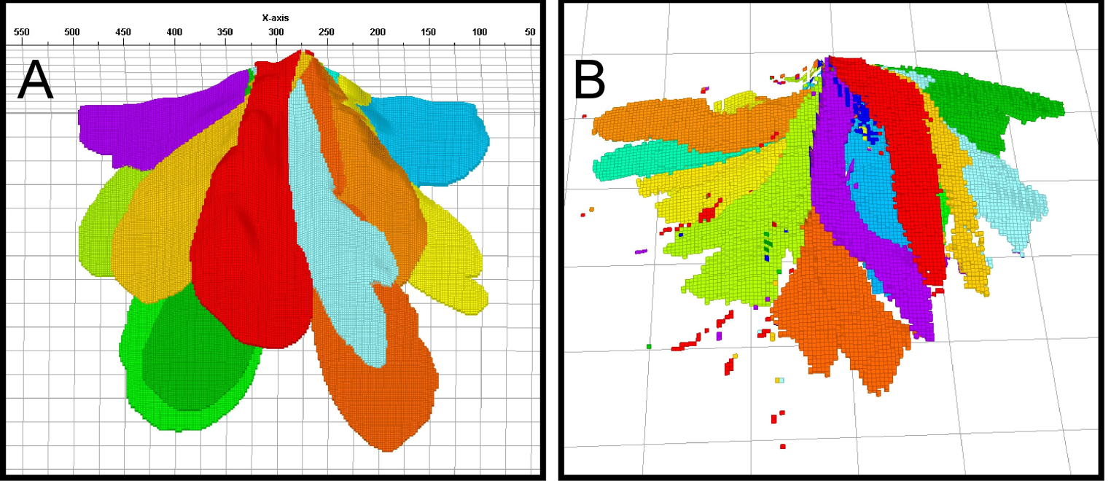
Idea: mimic the physical process with a “statistical process”
Process model
Boolean or object model
Weeks
Seconds
(Quantifying uncertainty is possible)

Slide 37
The object-based or Boolean model
Modeling spatial continuity

Slide 38
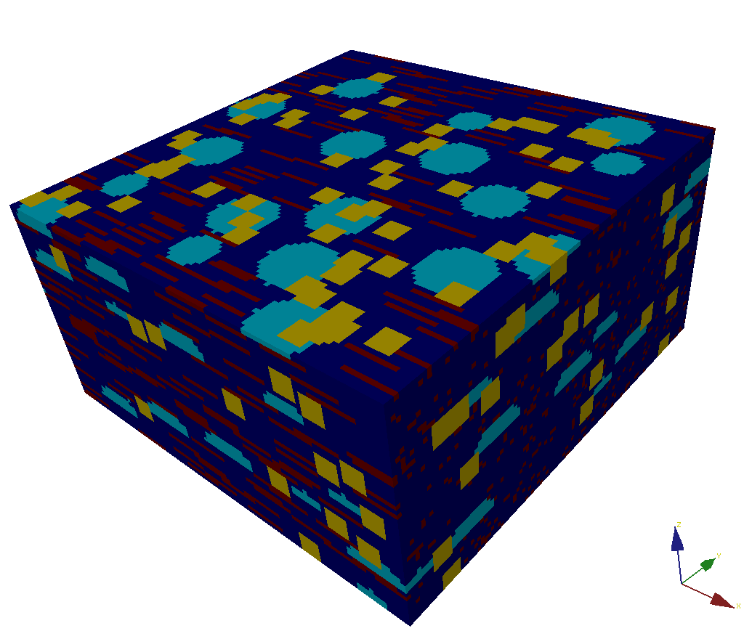
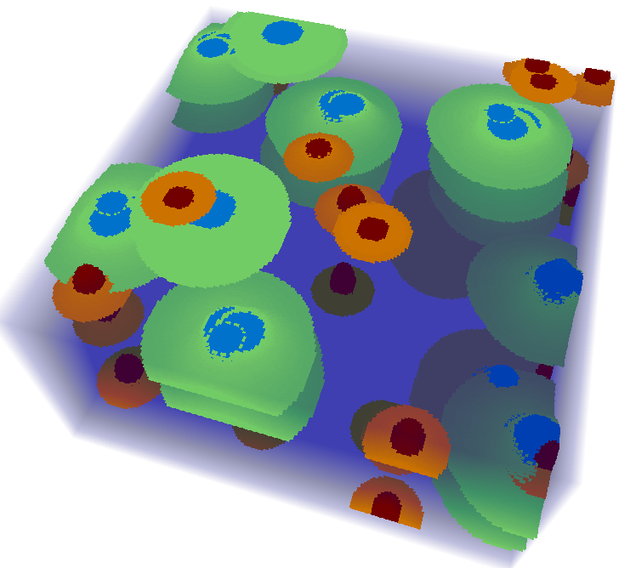
Object (Boolean) model
Define spatial variation as a set of objects, each type of object defined
using a limited set of parameters
Define spatial placement of an object and interaction between objects
We can raster the objects on a grid

Slide 39
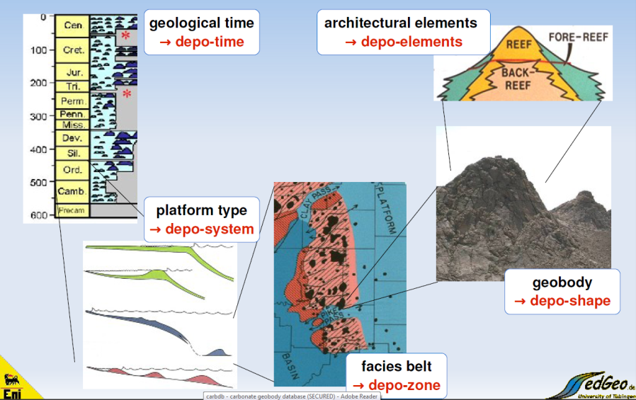
Building a Boolean model
Carbonate Geology

Slide 40
Hierarchy
Depo-Time: era of deposition
Depo-system: deepwater, fluvial, deltaic…
Depo-zones: regions with similar depo-shapes
Depo-shapes: basic geometries, geobodies
Depo-elements: internal architectures
Depo-facies: lithologies, associations

Slide 41
Constructing a Boolean model
Define a hierarchy of objects
Define object geometry
Define internal “architecture” of the object
Define placement of object spatially
Define interaction between objects

Slide 42
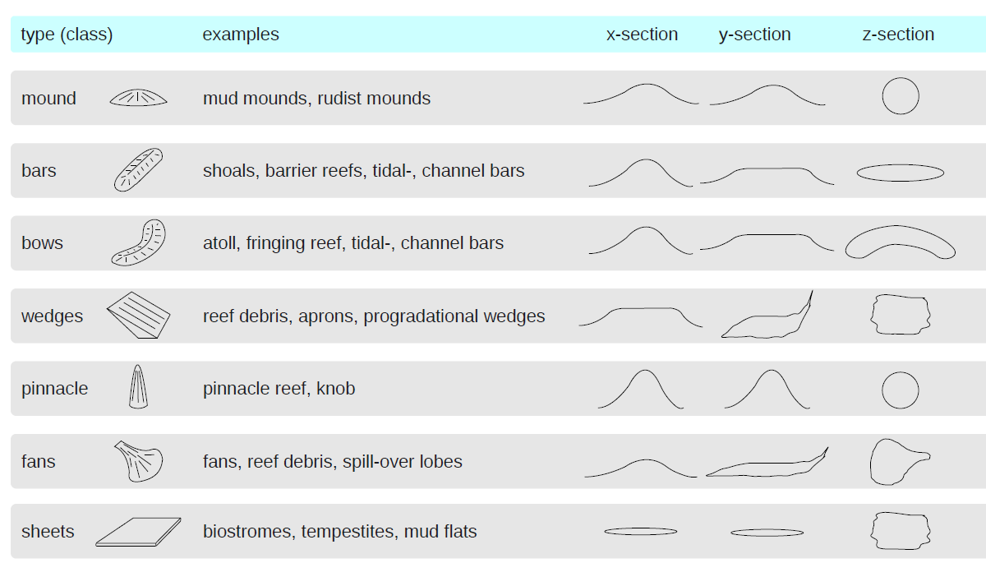
Geometries/dimensions
Example
Internal parameters of the object
those parameters defining geometries (e.g. width, length, orientation)
External variables controlling the shape
spatial properties such as topography, water depth that control shape

Slide 43
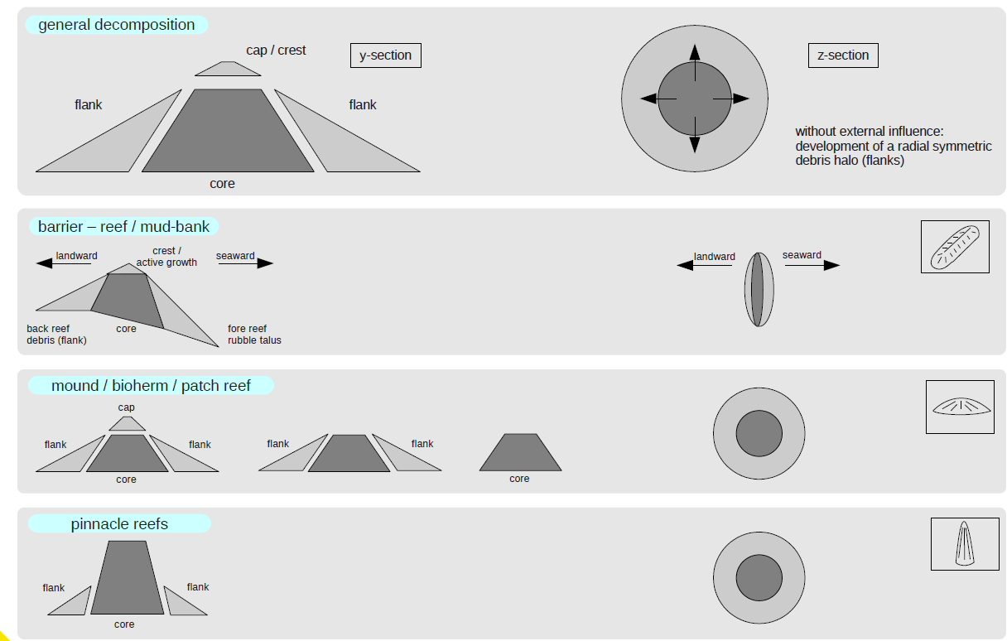
Architectural elements
Example

Slide 44

Spatial distribution
Most basic statistical process
= Poisson Process

Slide 45

Extensions of Poisson
Poisson process with
spatially varying intensity
(density of points)
Cluster Process

Slide 46

Marked Poisson process
Each poisson point gets
a “mark” which could be
an object with varying size

Slide 47
Rules
Spatial distribution of depo-shapes: default = Poisson process
Interaction between depo-shapes (overlap and erosion)
Rules are parameterized with internal parameters(e.g. Poisson intensity) that may be controlled by external variables (e.g. topography)

Slide 48



Parameterization of the object
Every parameter can be defined as constant or a distribution
Parameter values can be either constant or following an intensity function (locally varying property)
Angles
Shear
-45
0
45
-0.6
0
0.6

Slide 49


Carbonate mounds on a anticline
Increased shearing
Decreasing outer envelope
Rapidly decreasing core size
Mound
Inner part function of the slope

Slide 50

Positioning
Intensity Field

Slide 51

Stacking

Slide 52
Stacking
cdf
Δx
cdf
Δy
Base plane

Slide 53
Interaction between objects
Hierarchy by the order of definition
First defined object erodes the second one etc…
Overlap rules
No overlap
Full overlap
Attach

